Slide 1
COMP3017 Service Computing

Slide 2

Module Five: Service Oriented Architecture: architectural patterns and modelling methods of SOA, designing a distributed service system with SOA

Slide 3
Our materials for this module:
Thomas Erl, Service-Oriented Architecture, Concepts, Technology, and Design, ISBN：9787030336422，
Chapter 3
Chapter 8
Online resources: https://www.guru99.com/soa-principles.html

Slide 4
Module 5 Learning Outcomes
Analyze common characteristics of SOA
List common benefits of using SOA
Assess common pitfalls of adopting SOA
Understand the service orientation in the enterprise
Be familiar with anatomy of a service oriented architecture
Be able to explain the common principles of service orientation
Understand how service orientation principles inter-relate
Be able to evaluate Web service support for service-orientation principles

Slide 5
Guided questions for Module 5
What does the “service oriented” concept mean?
What is a service oriented architecture?
What are services within SOA?
What is a business process?
How is a service related to a business process?
How services relate to each other within SOA?
How services communicate?
How services are designed?

Slide 6
Guided questions for Module 5
What are the principles of service-orientation?
What are characteristics of contemporary SOA?
What are the benefits of SOA?
What are the pitfalls of adopting SOA?
How service orientation applies to the enterprise
How service orientation principles inter-relate?
How Web services support service orientation principles?

Slide 7
Service Oriented Architecture

Slide 8
Architecture
The process of planning, designing and constructing structures

Slide 9
Software Architecture
Structures of a software system and the discipline of creating such structures and systems
Each structure compromises
Software elements
Relations among the elements
Properties of elements
Properties of relations

Slide 10
Service Oriented Architecture
A style of software design where services are provided to the other companies by application components, through a communication protocol over a network

Slide 11
What is SOA?
Service-Oriented Architecture (SOA) is a set of principles and methodologies for designing and developing software in the form of interoperable services.
These services are well-defined business functionalities that are built as software components that can be reused for different purposes.

Slide 12
SOA Service
A discrete unit of functionality that can be accessed remotely and acted upon and updated independently
A repeatable task, for example:
• Open an account
• Perform a credit check
• retrieving a credit card statement online

Slide 13
Anatomy of a Service
New Service
Service Consumer
Wrapped
Legacy
Interface Proxy
Composite
Service
Service
Interface
Service
Implementation

Slide 14
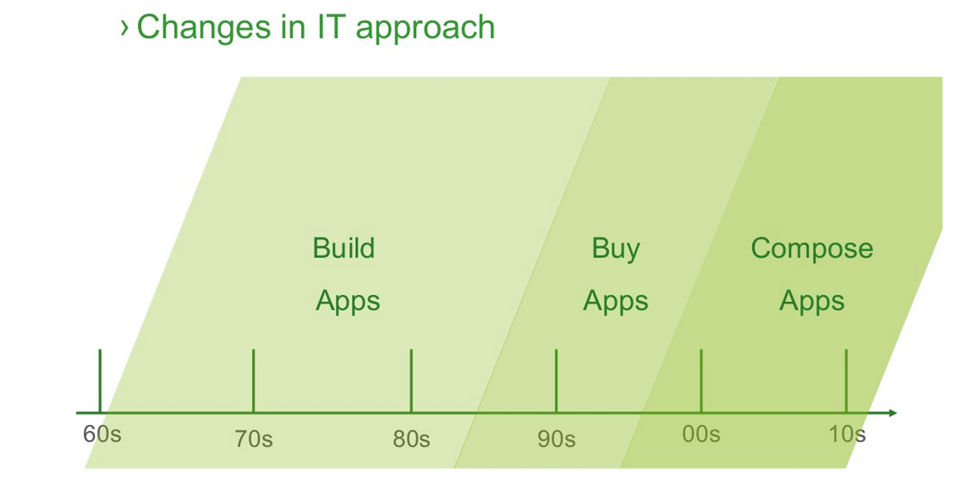
How did it come to SOA?

Slide 15
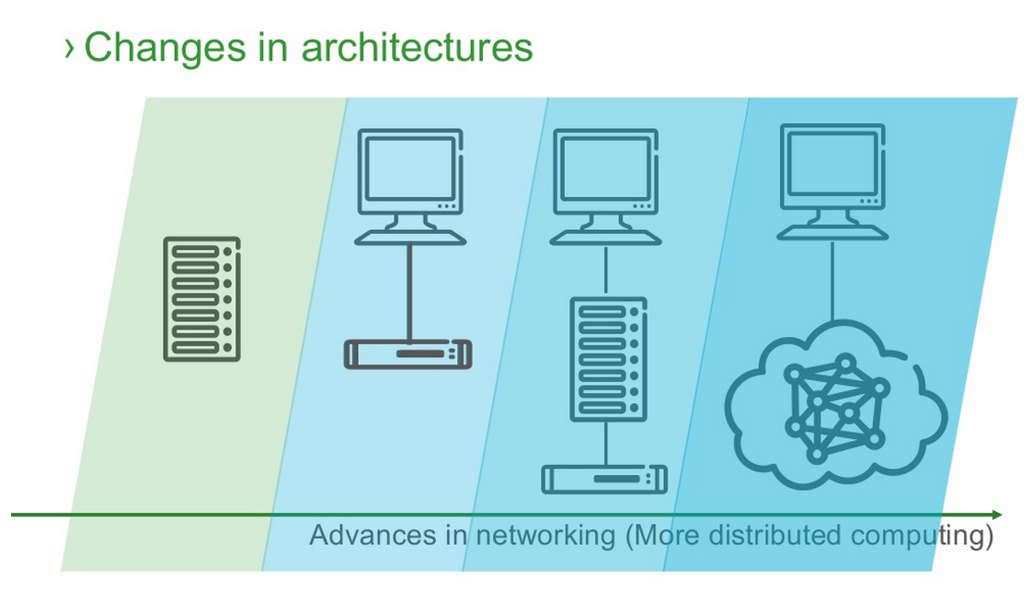
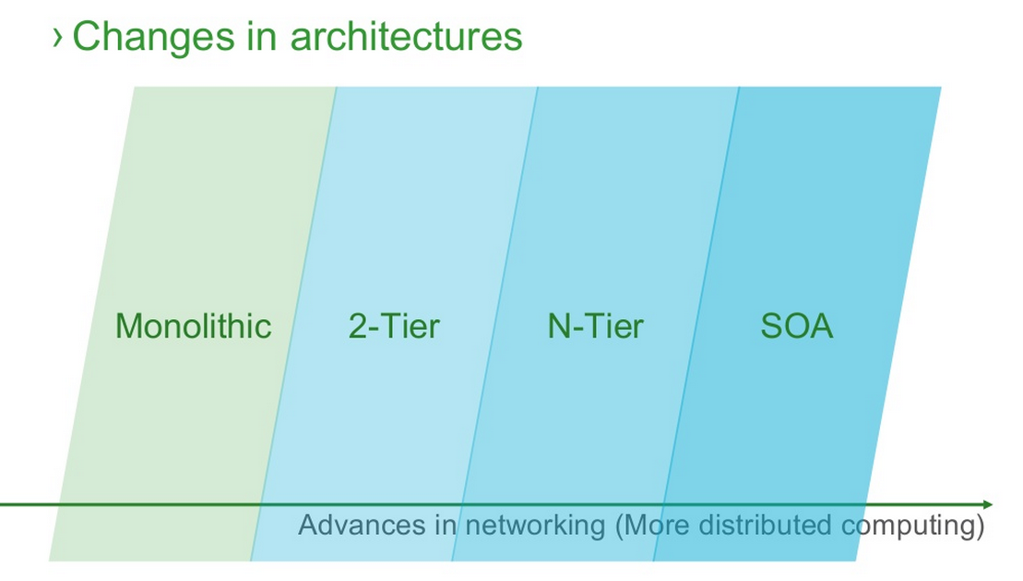
How did it come to SOA?

Slide 16
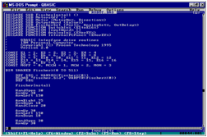
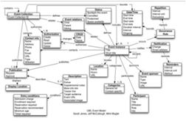
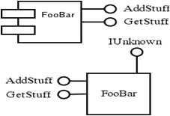
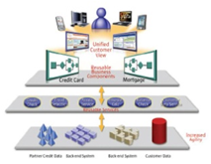
How did it come to SOA?
Object Oriented
Service Oriented
Procedural Oriented
Component Oriented

Slide 17
Why SOA in Enterprise?
Why to introduce SOA in an organization? What are the benefits for enterprises?

Slide 18
Why SOA?
From application centric to service centric environment

Slide 19

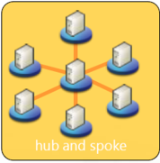
Application Centric
Business scope
Narrow Consumers Limited Business Processes
Finance
Integration
Architecture
bound to EAI vendor
Supply
Redundancy
Manufacturing
Distribution
Overlapped resources Overlapped providers
EAI ‘leverage’ application silos with the drawback of data and function redundancy.
Business functionality is duplicated in each application that requires it.

Slide 20
Service Centric
Business scope
Multiple Service Consumers Multiple Business Processes
Finance
Service
Service
Supply
Service Architecture
Service
Shared
Services
Service
Manufacturing
Distribution
Multiple Discrete Resources Multiple Service Providers
Service virtualizes how that capability is performed, and where and by whom the resources are provided, enabling multiple providers and consumers to participate together in shared business activities.
SOA structures the business and its systems as a set of capabilities that are offered
as Services, organized into a Service Architecture
Notes:
structures the business and its systems as a set of capabilities that are
<CLICK> offered as Services organized into a service architecture
and where the Service virtualizes how that capability is performed, and where and by whom the resources are provided,
enabling
<CLICK> multiple providers and consumers to participate together in shared business activities.

Slide 21
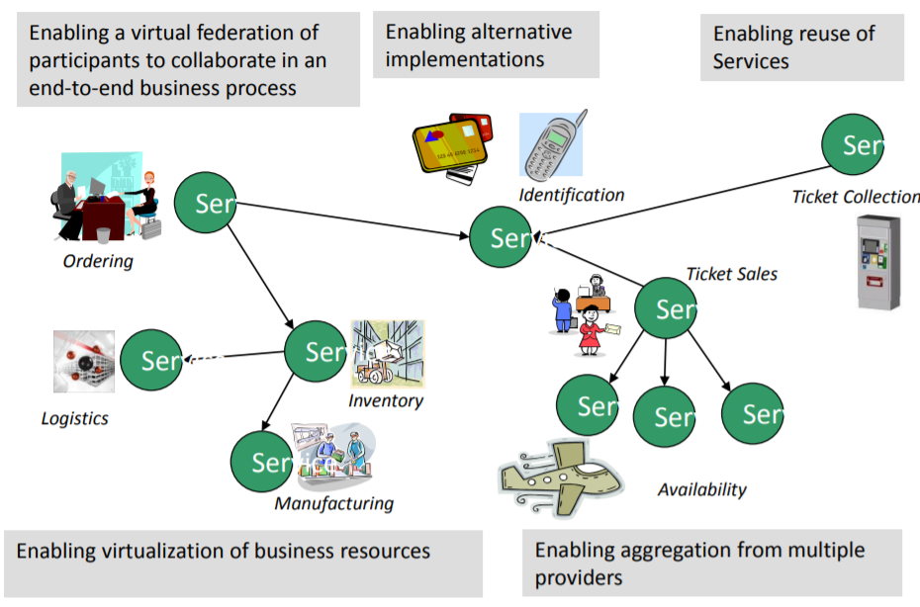
Why SOA in Enterprises? ENABLE FLEXIBLE, FEDERATED BUSINESS PROCESSES
Enable flexible, federated business processes

Slide 22
Business benefits – decreased cost
Decreased cost:
Add value to core investments by leveraging existing assets
New systems can be built faster for less money
Reducing integration expense
Built for flexibility
Long term value of interoperability

Slide 23
Business benefits – increased productivity
Increased employee productivity:
Built on existing skills
Consolidate duplicate functionality

Slide 24
Business benefits - partnership
Built for partnerships:
Standards based
Business relationships expressed via service interactions
Integration is driven by what is needed, not what is technically possible

Slide 25
Business benefits – agility
Agility - Built for change
Helps applications evolve over time and last
Abstract the backend and replace over time
Focusing on core-competencies
Incremental implementation approach is supported
Service Outsourcing – new business model!

Slide 26
Technical Benefits
Services Scale
Build scalable, evolvable systems
Scale down to mobile devices
Scale up to for large systems or across organizations

Slide 27
Technical Benefits
Services Scale
Build scalable, evolvable systems
Scale down to mobile devices
Scale up to for large systems or across organizations
Manage complex systems
Does not require centralized services
Empowers users with high end communication

Slide 28
Technical Benefits
Services Scale
Build scalable, evolvable systems
Scale down to mobile devices
Scale up to for large systems or across organizations
Manage complex systems
Does not require centralized services
Empowers users with high end communication
Platform independent use

Slide 29
Technical Benefits
Services Scale
Build scalable, evolvable systems
Scale down to mobile devices
Scale up to for large systems or across organizations
Manage complex systems
Does not require centralized services
Empowers users with high end communication
Platform independent use
Loose Coupling allows flexibility

Slide 30
Web Services vs SOA
Are SOA and Web Services the same thing?

Slide 31
Web Services vs SOA
Web services and SOA are not synonymous.

Slide 32
Web Services vs SOA
Web services and SOA are not synonymous.
SOA is a design principle, whereas web services is an implementation technology.

Slide 33
Web Services vs SOA
Web services and SOA are not synonymous.
SOA is a design principle, whereas web services is an implementation technology.
You can build a service-oriented application without using web services

Slide 34
Web service implementation of SOA
Service-oriented architecture can be implemented with web services.
Functional building blocks are accessible over standard internet protocols
Independent of platforms and programming languages
Web services can represent
New applications
Wrappers around existing legacy systems
SOA can be implemented using other technologies

Slide 35
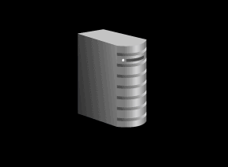
Basic Web Services
UDDI Registry
Points to
description
WSDL
Points to service
Finds
Service
Describes
Service
Web Service
Client
(J2EE, .NET, PL/SQL …)
SOAP
Web Service
(J2EE, PL/SQL, .NET,C/C++, Legacy …)
Invokes with
XML Messages

Slide 36
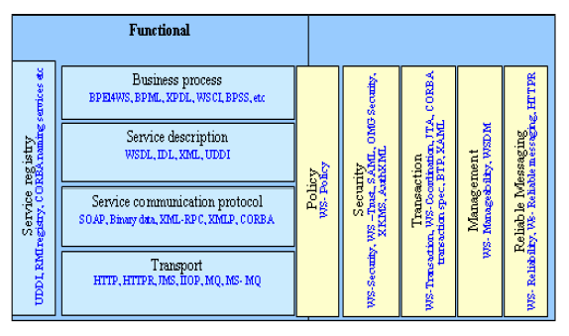
SOA Standards Stack

Slide 37
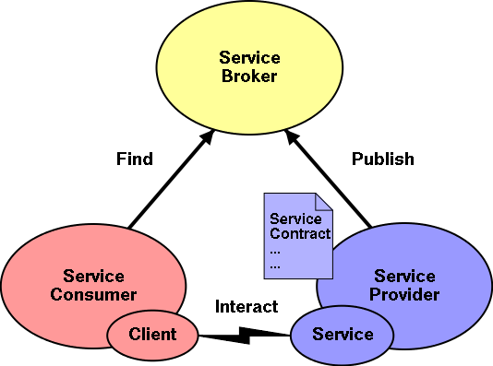
SOA Architecture

Slide 38
Basic Components of an SOA
SOA consists of the following three components:
Service provider
Service consumer
Service registry
Each component can also act as one of the two other components.
For instance, if a service provider needs additional information that it can only acquire from another service, it acts as a service consumer.

Slide 39

Poll
1 answer(s) at most
In your opinion, if the enterprise decides to use SOA paradigm, is it necessary for all the IT functions in this company to become services?
A
Yes, only then the SOA will be successful
B
No, we should select carefully which IT functions should become services
Submit

Slide 40
Characteristics of service-oriented architectures
Any function can be a service but need not be.

Slide 41
Open Question
Points: 10
Please complete this sentence:
The criteria for whether a function needs to be a service should be based on ……………………………...
Open Question is only supported on Version 2.0 or newer.
Answer

Slide 42
Recall our definition - What is SOA?
Service-Oriented Architecture (SOA) is a set of principles and methodologies for designing and developing software in the form of interoperable services.
These services are well-defined business functionalities that are built as software components that can be reused for different purposes.
SOA design principles are used during the phases of systems development and integration.

Slide 43
Recall our definition - SOA Service
A discrete unit of functionality that can be accessed remotely and acted upon and updated independently
A repeatable task, for example:
• Open an account
• Perform a credit check
• retrieving a credit card statement online

Slide 44
Characteristics of service-oriented architectures
Any function can be a service but need not be. The criteria for whether a function needs to be a service is based on its reuse potential
Business process services
createStockOrder, reconcileAccount, renewPolicy
Business transaction services
checkOrderAvailability, createBillingRecord
Business function services
calculateDollarValueFromYen, getStockPrice
Technical function services
auditEvent, checkUserPassword,checkUserAuthorisation

Slide 45
Service Design Principles
The principles of service-orientation provide a means of supporting and achieving a foundation paradigm based upon building of SOA characteristics.

Slide 46
Common Service Design Principles
Standardized Service Contracts
Loose Coupling
Abstraction
Reusability
Autonomy
Statelessness
Discoverability
Composability

Slide 47
Standardized Service Contracts
Services share a formal contract
Services adhere to a communications agreement as defined collectively by one or more service description documents
For services to interact, they need not share anything but a formal contract that describes each service and defines the terms of information exchange.

Slide 48
Standardized Service Contracts in SOA Architecture

Slide 49
Open Question
Points: 10
How is the principle of standardized service contracts supported in the Web Services?
Open Question is only supported on Version 2.0 or newer.
Answer

Slide 50
Service contract goals
Reduce the need for data transformations as two services interact with each other
If the services have been implemented as web services, this is achieved when the service contracts use standardized data models e.g. XML schemas (interoperability of the services will also be improved)
Use a standardized way of expressing service capabilities so that their purpose and ability can be easily understood at design time
In Web Services, WSDL is a specification defining how to describe web services in a common XML grammar

Slide 51
WSDL – standardized service contracts support in Web Services
WSDL is a specification defining how to describe web services in a common XML grammar.
WSDL describes four critical pieces of data:
Interface information describing all publicly available functions
Data type information for all message requests and message responses
Binding information about the transport protocol to be used
Address information for locating the specified service

Slide 52
Loose Coupling
Services are loosely coupled
Services maintain a relationship that minimizes dependencies and only maintain an awareness of each other
Services must be designed to interact without the need for tight, cross-service dependencies
A service is defined solely by an implementation-independent interface
Services should be able to change their implementation without impacting service consumers

Slide 53

Abstraction
Services abstract underlying logic
Beyond what is described in the service contract, services hide logic from the outside world
The only part of a service that is visible to the outside world is what is exposed via the service contract. Underlying logic, beyond what is expressed in the descriptions that comprise the contract, is invisible and irrelevant to service requestors.

Slide 54
Reusability
Services are reusable
Logic is divided into services with the intention of promoting reuse
Regardless of whether immediate reuse opportunities exist; services are designed to support potential reuse

Slide 55
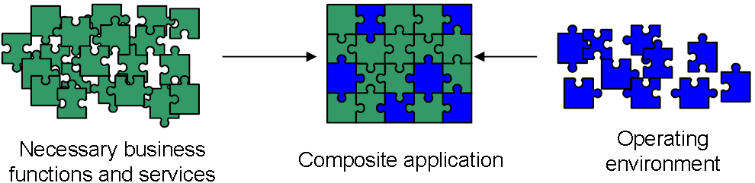
Service design principles: Reusability
Concept
A service interface should be designed with reuse in mind
Anticipate reuse scenarios

Slide 56
Reusability
Consequences
Well factored service interfaces:
Anticipate usage scenarios and consequently facilitate reuse
Poorly factored service interfaces:
Hinder reuse and encourage functional duplication, which can result in architectural decay (loss of architectural integrity over time)

Slide 57
Open Question
Points: 10
We just said that a service interface should be designed with reuse in mind. In Web services, WSDL describes the interface to the system. What can we do to enhance reusability when building applications based on Web Services?
Open Question is only supported on Version 2.0 or newer.
Answer

Slide 58
WSDL Authoring Style Recommendation helps with reusability of Web Services
Maintain WSDL document in 3 separate parts
– Data type definitions
– Abstract definitions
– Specific service bindings
Use “import” element to import necessary part of WSDL document

Slide 59
Autonomy
Services are autonomous
Services have control over the logic they encapsulate
The logic governed by a service resides within an explicit boundary. The service has control within this boundary and is not dependent on other services for it to execute its governance.

Slide 60
Statelessness
Services are stateless
Services should not be required to manage state information, as that can impede their ability to remain loosely coupled. Services should be designed to maximize statelessness even if that means deferring state management elsewhere.
Service implementations should not hold conversational state across multiple requests.
Communicate complete information at each request.
Each operation should be functionally isolated (separate, independent).

Slide 61
Discoverability
Services are discoverable
Services are designed to be outwardly descriptive so that they can be found and assessed via available discovery mechanisms
Services should allow their descriptions to be discovered and understood by humans and service requestors that may be able to make use of their logic.

Slide 62
Composability
Services are composable
Collections of services can be coordinated and assembled to form composite services
Services may compose other services. This allows logic to be represented at different levels of granularity and promotes reusability and the creation of abstraction layers.

Slide 63
Poll(Anonymous)
1 answer(s) at most
Which service design principle is in your opinion the most important?
A
Services share a formal contract
B
Services are loosely coupled
C
Services abstract underlying logic
D
Services are reusable
E
Services are autonomous
F
Services are stateless
G
Services are discoverable
H
Services are composable
Submit

Slide 64
Service Design Principles

Slide 65
Do service orientation principles interrelate?
How principles can relate to and affect each other?
What is the cause and effect of applying each of the common principles?
Standardized Service Contracts
Loose Coupling
Abstraction
Reusability
Autonomy
Statelessness
Discoverability
Composability

Slide 66
Open Question
Points: 10
Can reusability be affected by applying other principles? How?
Answer

Slide 67
Service reusability relationship with other principles
Service autonomy establishes an execution environment that facilitates reuse because the service achieves increased independence and self-governance.
The less dependencies a service has, the broader its reuse applicability.

Slide 68
Service reusability relationship with other principles
Service statelessness supports reuse because it maximizes the availability of a service and typically promotes a generic service design that defers state management and activity-specific processing outside of the service boundary.

Slide 69
Service reusability relationship with other principles
Service abstraction fosters reuse because it establishes the black box concept.
Proprietary processing details are hidden and potential consumers are only made aware of an access point represented by a generic public interface.

Slide 70
Service reusability relationship with other principles
Service discoverability promotes reuse as it allows those that build consumers to search for, discover and assess services offering reusable functionality.

Slide 71
Service reusability relationship with other principles
Service loose coupling establishes an inherent independence that frees a service from immediate ties to others. This makes it a great deal easier to realize reuse.

Slide 72
Open Question
Points: 10
Will applying the principle of reusability have impact on any other principle? Which one?
Answer

Slide 73
Service reusability relationship with other principles
Service composability is primarily possible because of reuse.
The ability for new automation requirements to be fulfilled through the composition of existing services is feasible when those services being composed are built for reuse.

Slide 74
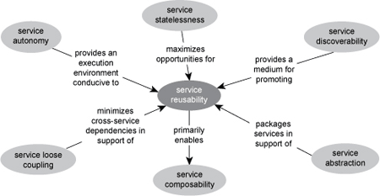
Service reusability relationship with other principles

Slide 75
Common Service Design Principles
Standardized Service Contracts
Loose Coupling
Abstraction
Reusability
Autonomy
Statelessness
Discoverability
Composability

Slide 76
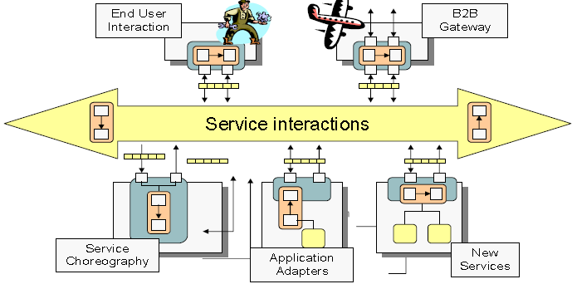
Loose coupling is enabled by an ESB
An ESB (enterprise service bus) is an intermediary-oriented approach
Notes:
– Instead of thinking about consuming services across a network, think
of a service bus as a network of collaborating services
– a set of applications exposed as services, plus a separate set of
intermediary services that perform security, monitoring, and so forth
– You can add new intermediaries without disrupting existing
applications

Slide 77
Service Communication
Communicate with messages
No knowledge about partner
Likely heterogeneous
Providing reliability and security to messages
Sending messages across consumers and producers
Service Orchestration
Service Consumers
Service Producers

Slide 78
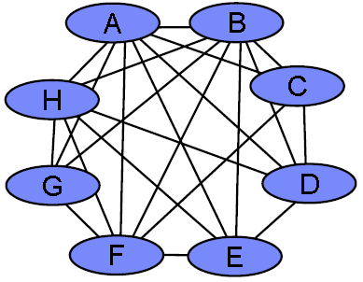
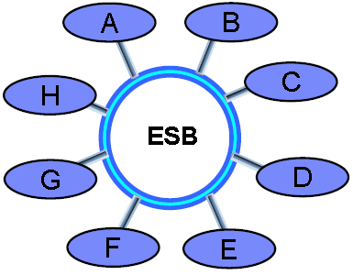
Point-to-point service interactions

Slide 79
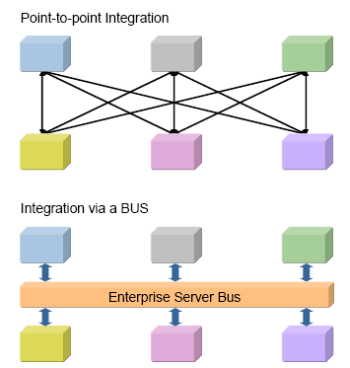
Overcoming the Problems of Point-to-point Integration with ESB

Slide 80
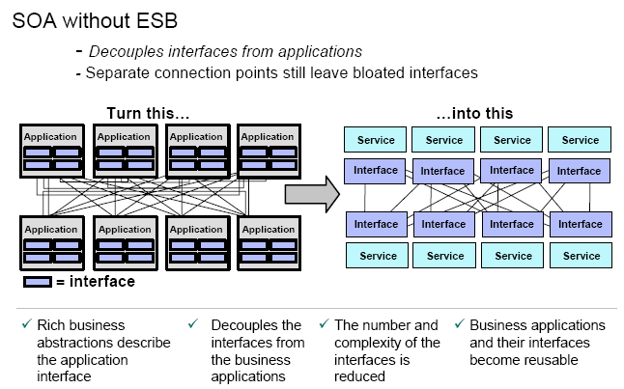

Slide 81
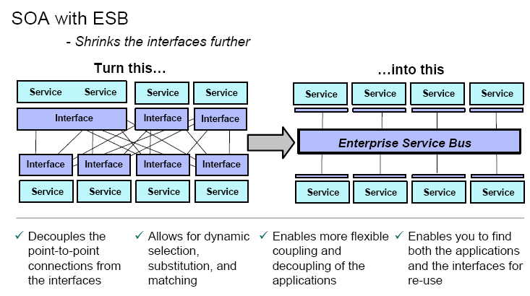

Slide 82
The ESB Architecture
The purpose of the ESB is so that common specifications, policies, etc can be made at the bus level, rather than for each individual service.

Slide 83
Where not to use SOA?
We discussed many benefits of SOA. Can you think of any scenario when SOA would NOT be a preferred choice?

Slide 84
Open Question
Points: 10
We discussed many benefits of SOA. Can you think of any scenario when SOA would NOT be a preferred choice?
Open Question is only supported on Version 2.0 or newer.
Answer

Slide 85
Applying SOA - Challenges
Business functionality has to be made available as services. Service contracts must be fixed
Service Orientation
Reuse
Sharing of Responsibilities
Increased complexity!
Implemented services must be designed with reuse in mind. This creates some overhead.
Potential service users must be involved in the design process and will have influence on the service design
Notes:
Independence from Technology - Dependency on the underlying IT infrastructure is reduced so that business departments can focus on functional requirements.
Shorter Time to Market- Business departments can achieve a shorter time to market for new functionality.
Reduction of Development Costs- The costs for developing new functionality are significantly reduced.
Service Orientation- Business functionality has to be made available as services. Service contracts must be fixed and adhered to.
Reuse- Implemented services must be designed with reuse in mind. This creates some overhead.
Sharing of Responsibilities- Potential service users must be involved in the design process and will have influence on the service design.

Slide 86
Where not to use SOA?
When you have homogenous IT environment

Slide 87
Where not to use SOA?
When you have homogenous IT environment
When real time performance is critical

Slide 88
Where not to use SOA?
When you have homogenous IT environment
When real time performance is critical
When tight coupling is a pro not a con

Slide 89
Where not to use SOA?
When you have homogenous IT environment
When real time performance is critical
When tight coupling is a pro not a con
When things don’t change

Slide 90
Module 5 Summary
Architectural patterns of SOA
Designing distributed systems with SOA

